Slide 1
Developing an integrated approach for multiomic epigenetic analyses
Kathleen M. Durkin, J. Ashey, S. White, A.S. Huffmyer, Z. Dellaert, J. Rodriguez Casariego, Z. Bengtsson, D.M. Becker, J. Eirin-Lopez, H.M. Putnam, S.B. Roberts

Slide 2

We must understand the mechanisms of environmental response to…
Predict how changes will affect organisms/populations
Identify populations and ecosystems most at risk
Inform management decisions
Notes:
Predict how environmental change will affect organisms/populations
Identify populations/ecosystems most at risk
Inform management decisions
Interventions
Protections
etc.

Slide 3
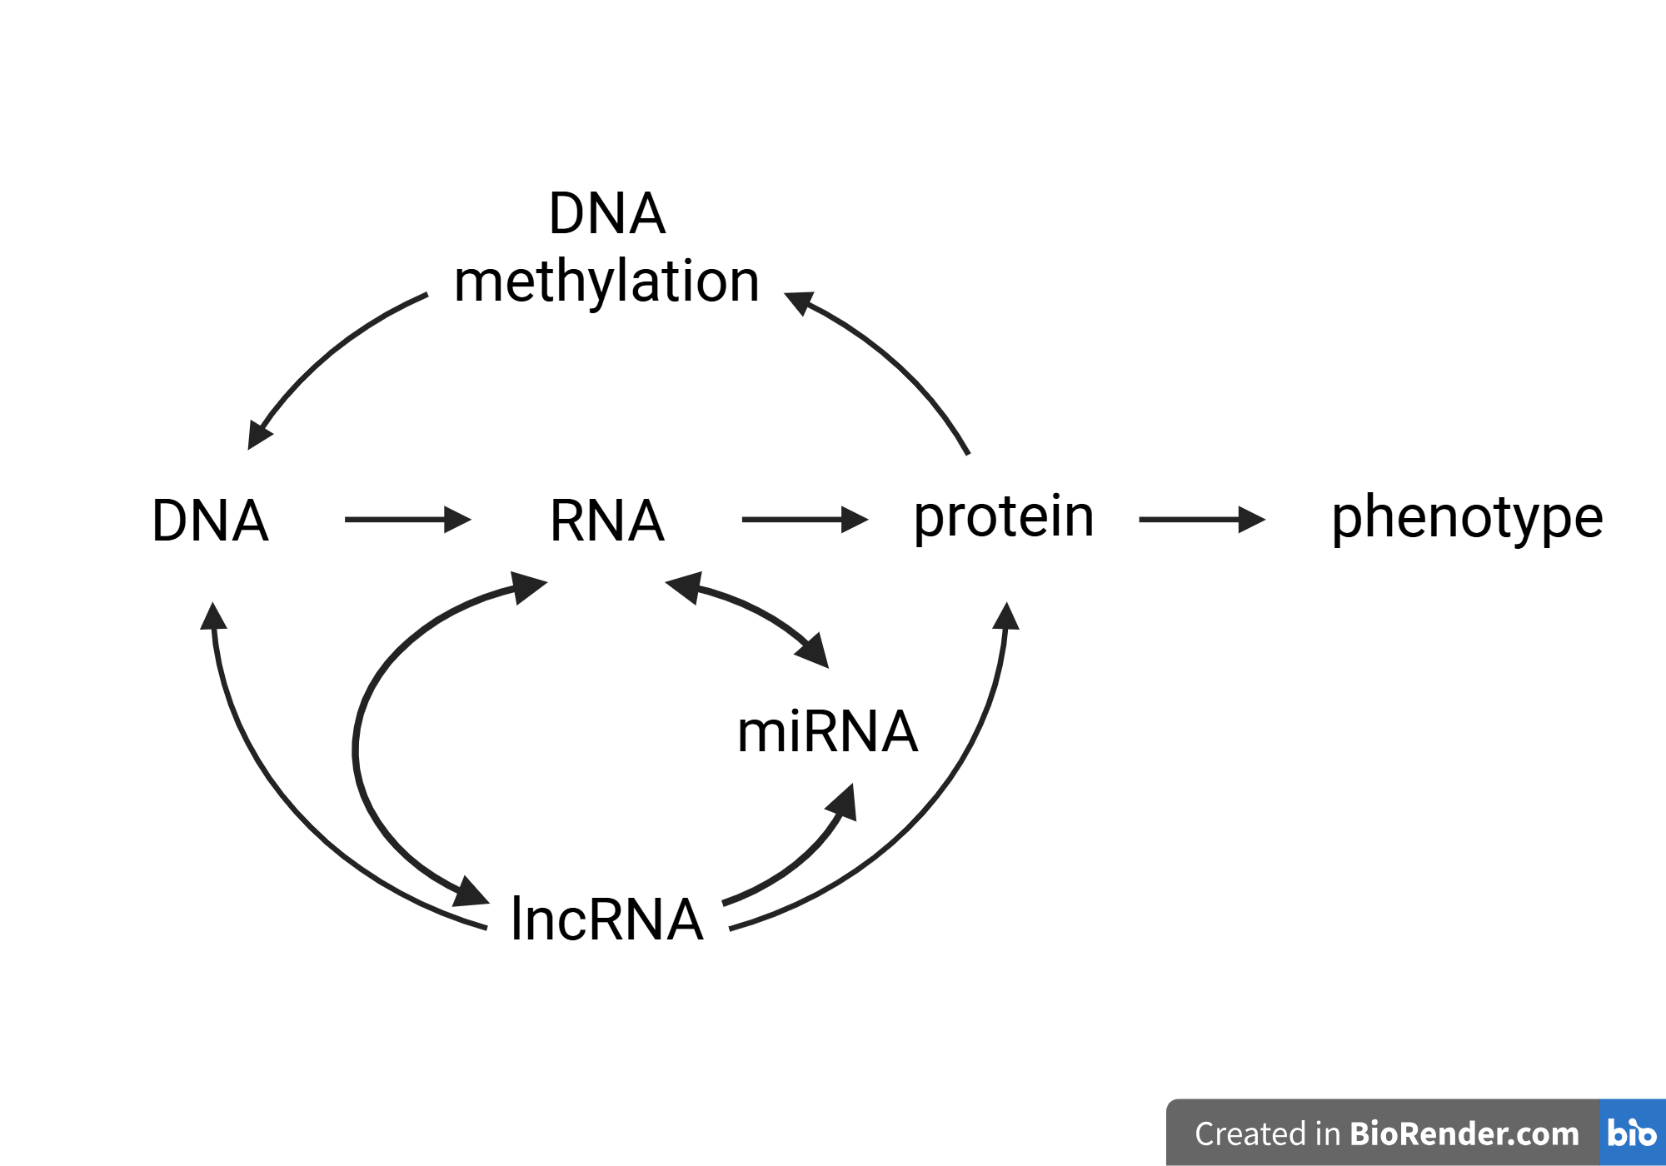
Information Flow
Notes:
“Root” audience w this figure as a reference throughout talk of which mechanism were discussing

Slide 4
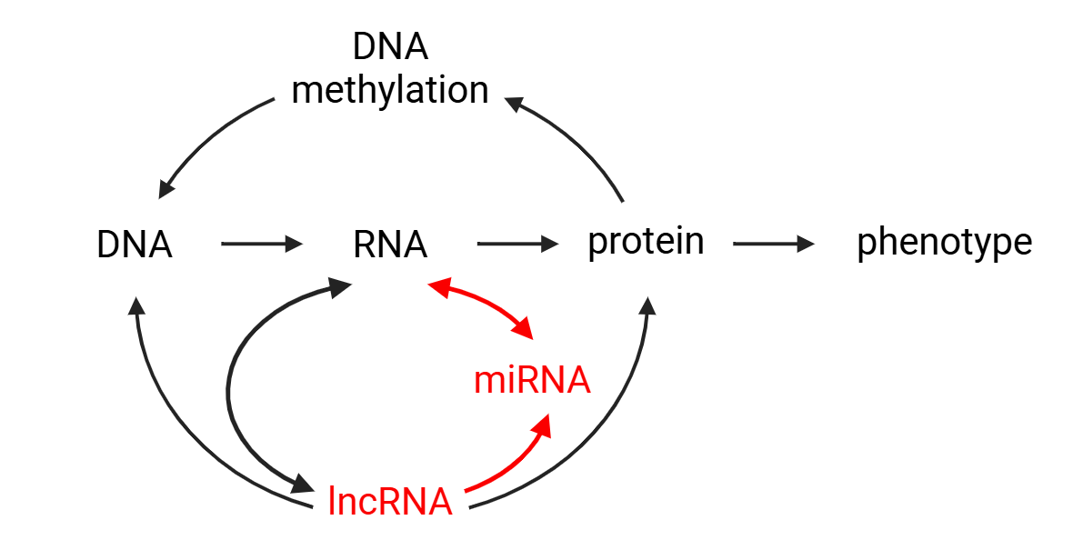
Information Flow
Notes:
“Root” audience w this figure as a reference throughout talk of which mechanism were discussing

Slide 5
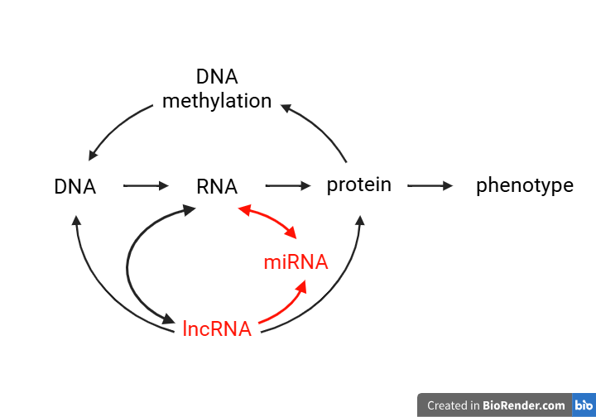
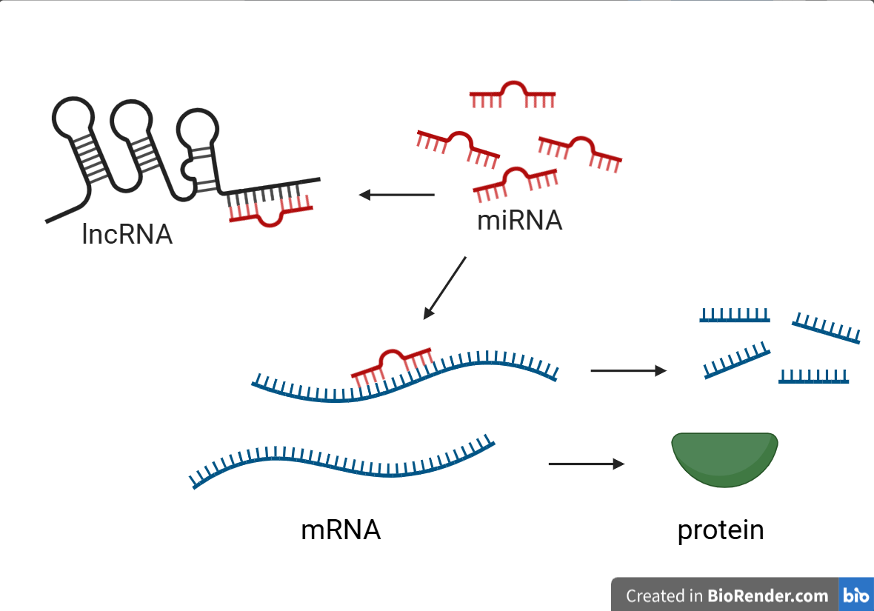

Slide 6
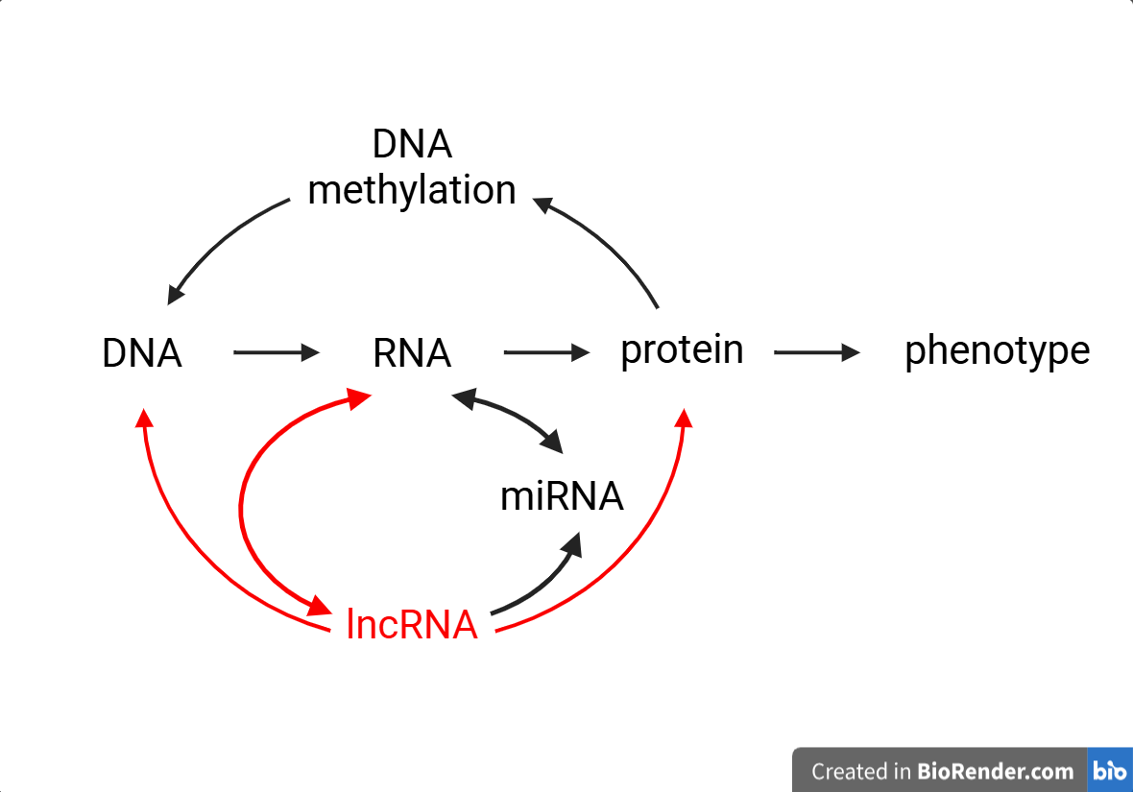
Information Flow
Notes:
“Root” audience w this figure as a reference throughout talk of which mechanism were discussing

Slide 7
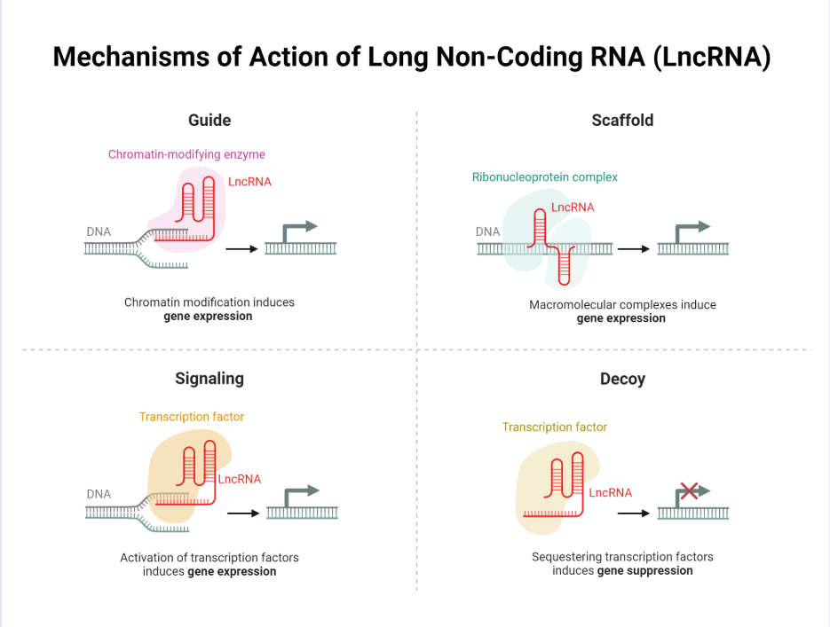
Maritan, M. (2024) BioRender.

Slide 8
Information Flow
?
Notes:
“Root” audience w this figure as a reference throughout talk of which mechanism were discussing

Slide 9
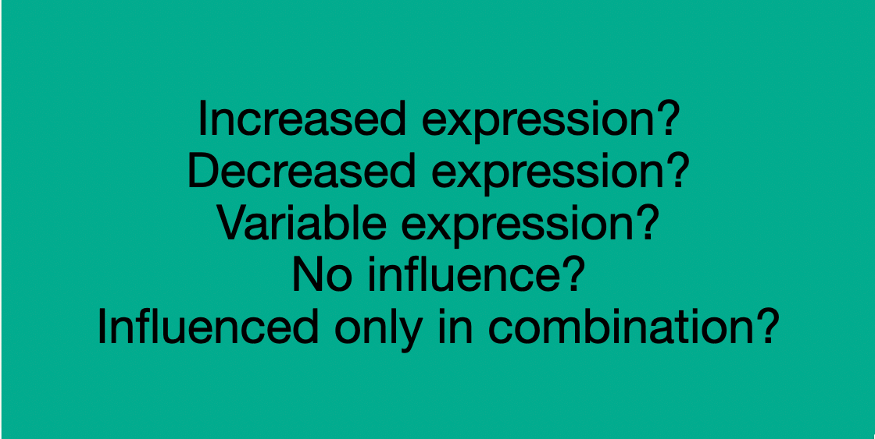
Information Flow
?
Notes:
“Root” audience w this figure as a reference throughout talk of which mechanism were discussing

Slide 10

Biological Hypotheses
A subset of epigenetic features (i.e. noncoding RNA and DNA methylation) regulate expression of genes that contribute to energetic processes.
Notes:
Why choose “energetic state” genes for use in the predictive model? Elastic net is a univariate regression model, meaning it can use a large predictor set to model the behavior of a *single* response variable (e.g. a gene) at a time. Due to computational requirements and the multiple testing problem, it was beneficial to choose a small set of genes as responses. When choosing genes we considered:
Biological relevance: As a fundamental biological process, we know their expression is intrinsically tied to physiology. Predicting their expression may allow us to also predict physiological state.
Variability: Similarly, know their expression is likely to be variable across time (supported by supported by differential host calcification, biomass, respiration over time), which will provide more information for model
Generalizability: core metabolic/energetic genes are more often highly conserved among taxa. Thus, the mechanisms of epigenetic modulation may also be generalizable

Slide 11
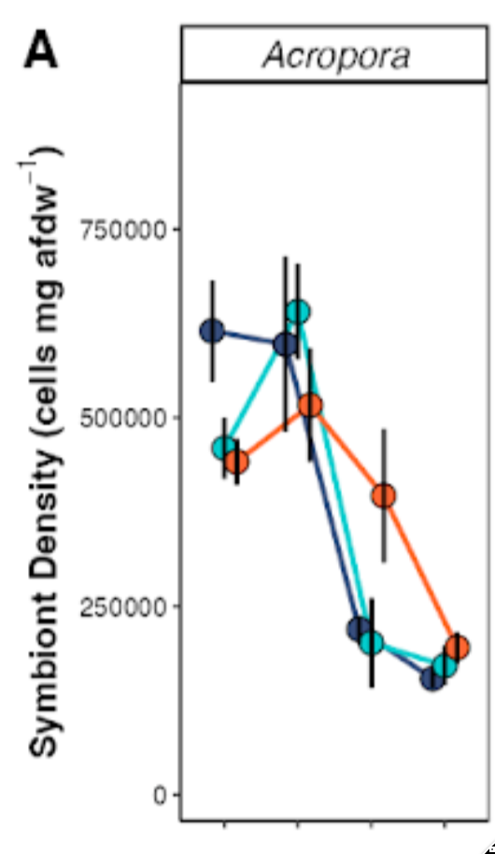
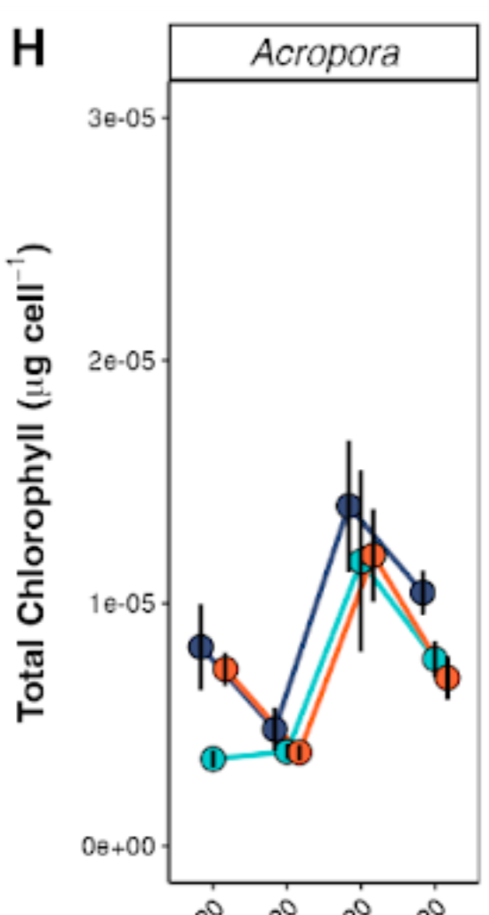
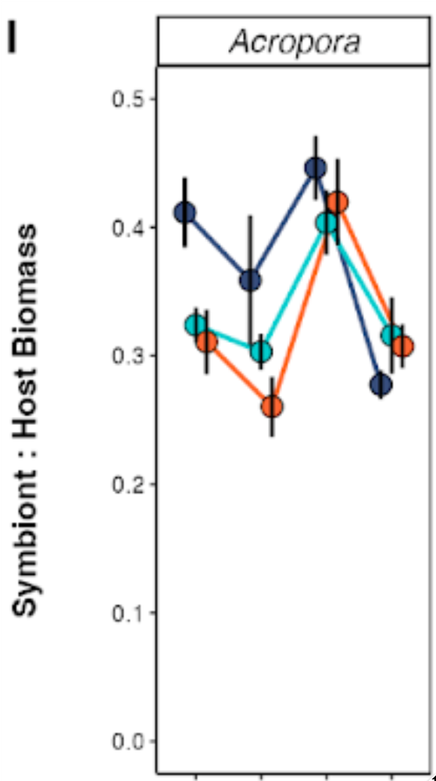
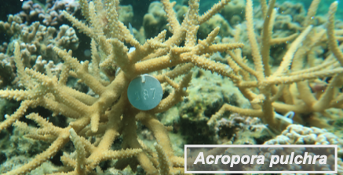
Experimental System
10 colonies
Sampled Jan., March, Sep., Nov. 2020
N = 40
RNA-seq
sRNA-seq
WGBS

Slide 12
ML Model – Elastic net regression
x 50 replicates
Training (80%) Testing (20%)
genes (selected)
predict gene expression from epigenetic features
miRNA
lncRNA
CpG methylation
Notes:
Used an elastic net regression to predict expression of these genes, using the combination of miRNA expression, lncRNA expression, and methylation state of CpG sites as a predictor.
80/20 train/test split, 50 replicates

Slide 13
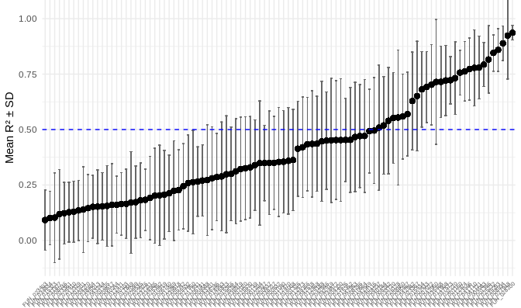
Epigenetic modulators predict expression for some genes
n=28
(poorly-predicted) energetic state genes (well-predicted)
Notes:
Get updated plot that’s less noisy. Maybe box and whisker showing summary stats of each set of replicates? Set horizontal line to be my R2 threshold. Also double check the axis names are good and reduce gene name size

Slide 14
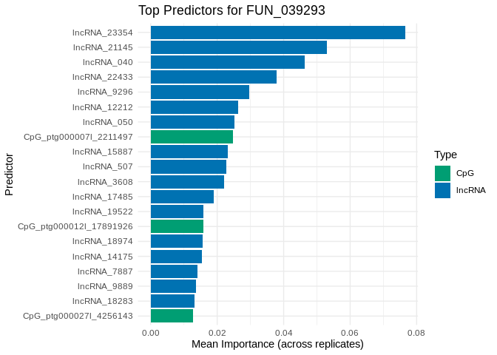
Glyceraldehyde-3-Phosphate Dehydrogenase (GAPDH)
lncRNA_23354 ⬆ lncRNA_21145 ⬇ lncRNA_040 ⬆ lncRNA_22433 ⬆ lncRNA_9296 ⬇
Importance to model prediction
Notes:
One of the best-predicted genes in our model.
Catalyzes a step in glycolisis, so central to glycolitic energy production.
Differentially expressed in a jellyfish under short-term temperature exposure (Gamero-Mora et al. 2024)
(note to self, this is one of two genes that code for GAPDH, the other is FUN_025232)

Slide 15
Glyceraldehyde-3-Phosphate Dehydrogenase (GAPDH)
lncRNA_23354 ⬆ lncRNA_21145 ⬇ lncRNA_040 ⬆ lncRNA_22433 ⬆ lncRNA_9296 ⬇
Notes:
One of the best-predicted genes in our model.
Catalyzes a step in glycolisis, so central to glycolitic energy production.
Differentially expressed in a jellyfish under short-term temperature exposure (Gamero-Mora et al. 2024)
(note to self, this is one of two genes that code for GAPDH, the other is FUN_025232)

Slide 16
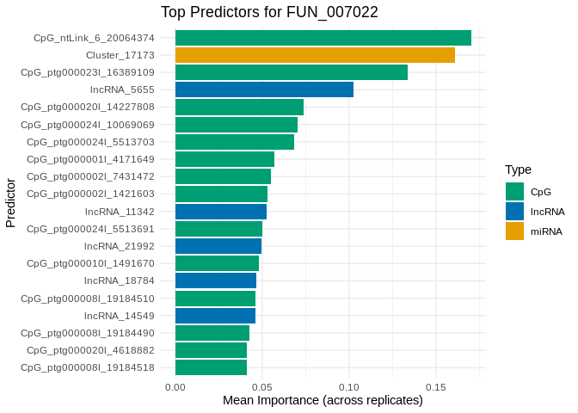
Cryptochrome-1 (CRY1)
CpG_ntLink_6_20064374 ⬇ miRNA_17173 ⬇ CpG_ptg000023l_16389109 ⬇ lncRNA_5655 ⬇ CpG_ptg000020l_14227808 ⬆
Importance to model prediction
Notes:
Core component of circadian clock, modulating metabolic pathways in time-dependent manner.
In plants, cryptochromes may be regulated by a network of miRNA and lncRNA
In corals, cryptochromes are involved in photoreception, potentially influencing behavior synchronization (e.g. mass spawning)
Cluster_17173 putatively binds to 3 locations of the FUN_007022 CDS.
Cluster_17173 putatively binds to 3 locations of lncRNA_5655

Slide 17
Cryptochrome-1 (CRY1)
Possible layered processes…
CpG hypomethylation enhancing transcriptional access
miRNA_17173 post-transcriptionally silencing
lncRNA_5655 sequestering TFs (decoy)
CpG_ntLink_6_20064374 ⬇ miRNA_17173 ⬇ CpG_ptg000023l_16389109 ⬇ lncRNA_5655 ⬇ CpG_ptg000020l_14227808 ⬆
Notes:
Core component of circadian clock, modulating metabolic pathways in time-dependent manner.
In plants, cryptochromes may be regulated by a network of miRNA and lncRNA
In corals, cryptochromes are involved in photoreception, potentially influencing behavior synchronization (e.g. mass spawning)
Cluster_17173 putatively binds to 3 locations of the FUN_007022 CDS.
Cluster_17173 putatively binds to 3 locations of lncRNA_5655
CpG_ntLink_6_20064374 sits in intron of a reverse transcriptase

Slide 18
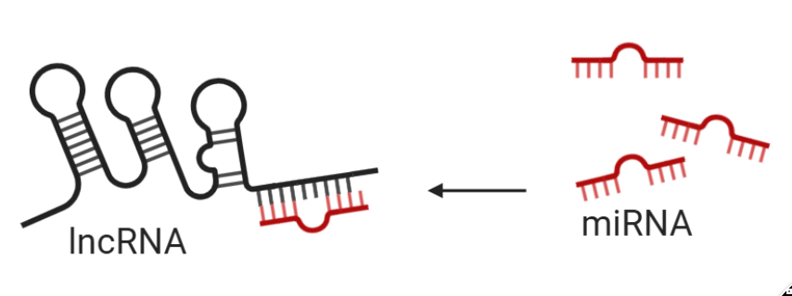
Cryptochrome-1 (CRY1)
CpG_ntLink_6_20064374 ⬇ miRNA_17173 ⬇ CpG_ptg000023l_16389109 ⬇ lncRNA_5655 ⬇ CpG_ptg000020l_14227808 ⬆
miRNA binds to gene
miRNA binds to lncRNA_5655
Notes:
Core component of circadian clock, modulating metabolic pathways in time-dependent manner.
In plants, cryptochromes may be regulated by a network of miRNA and lncRNA
In corals, cryptochromes are involved in photoreception, potentially influencing behavior synchronization (e.g. mass spawning)
Cluster_17173 putatively binds to 3 locations of the FUN_007022 CDS.
Cluster_17173 putatively binds to 3 locations of lncRNA_5655

Slide 19
Cryptochrome-1 (CRY1)
Possible layered processes…
CpG hypomethylation enhancing transcriptional access
miRNA_17173 post-transcriptionally silencing
lncRNA_5655 sequestering TFs (decoy)
lncRNA_5655 sequesters miRNA_17173 to mediate its effects
CpG_ntLink_6_20064374 ⬇ miRNA_17173 ⬇ CpG_ptg000023l_16389109 ⬇ lncRNA_5655 ⬇ CpG_ptg000020l_14227808 ⬆
miRNA binds to gene
miRNA binds to lncRNA_5655
Notes:
Core component of circadian clock, modulating metabolic pathways in time-dependent manner.
In plants, cryptochromes may be regulated by a network of miRNA and lncRNA
In corals, cryptochromes are involved in photoreception, potentially influencing behavior synchronization (e.g. mass spawning)
Cluster_17173 putatively binds to 3 locations of the FUN_007022 CDS.
Cluster_17173 putatively binds to 3 locations of lncRNA_5655
CpG_ntLink_6_20064374 sits in intron of a reverse transcriptase

Slide 20
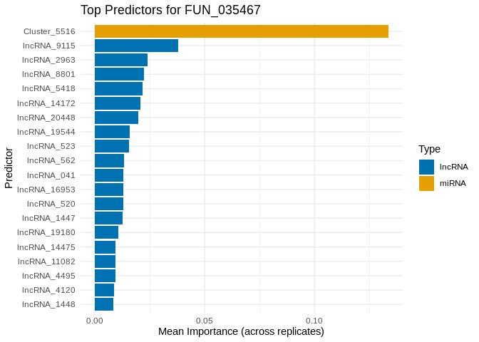
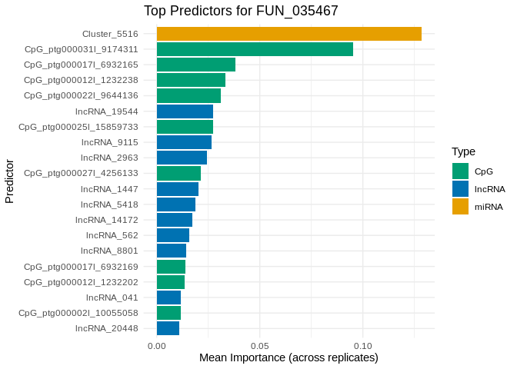
Phosphoenolpyruvate Carboxykinase [GTP], Mitochondrial (PEPCK-M)
Cluster_5516 ⬇ CpG_ptg000031l_9174311 ⬇ CpG_ptg000017l_6932165 ⬆ CpG_ptg000012l_1232238 ⬆ CpG_ptg022l_0644136 ⬆
miRNA binds to gene (5’UTR)
Importance to model prediction
Notes:
A rate-limiting enzyme that catalyzes a step of gluconeogenesis, essential to maintaining glucose levels during fasting.
In corals, the PEPCK pathway has been identified as a potential carbon fixation pathway within coral hosts to supplement other CO2 concentrating mechanisms, used to accumulate dissolved organic carbon in service of their symbionts. (Zhang et al., 2024)
PEPCK is also differentially expressed under heat stress and bleaching (e.g., Kenkel et al. 2013, Lee et al. 2018, Kenkel et al. 2014), which suggests its involvement in compensating for loss of symbiont-derived nutrients.
Multiple classes of ncRNA have recently been identified as putative regulators of glucose metabolism, in which phosphoenolpyruvate carboxykinase plays a key role (e.g., Lai et al., 2020)
Cluster_5516 putatively binds to FUN_035467 in the 5UTR, but not to any of its top lncRNA predictors

Slide 21
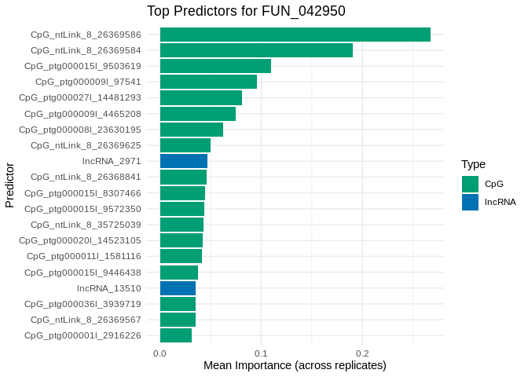
TNF Receptor-Associated Factor 2 (TRAF2)
CpG_ntLink_8 sites are adjacent, within gene for Proprotein convertase 5
CpG_ntLink_8_2636586 CpG_ntLink_8_26369584 CpG_ptg000015l_9503618 CpG_ptg000009l_97541 CpG_ptg000027l_14481293
Importance to model prediction
Notes:
In general, tumor necrosis factors (TNFs) play a role in apoptosis, and are associated with immune response and cellular stress response.
TRAF2, specifically, suppresses apoptosis and necroptosis (Petersen et al. 2015) In humans, dysregulation of TNFs and TRAFs is implicated in several cancer types.
TRAF2 has also been implicated as part of an immune regulation network that is modulated by both miRNA and lncRNA (Ebrahimi & Golestani 2021).
In Acropora hyacinthus, TNF receptor-associated factor 2 is downregulated in response to bleaching (Barshis et al., 2013).

Slide 22

Primary Findings - Biology
For a subset of genes associated with seasonally variable energetic phenotype, we’ve identified multiomic epigenetic features associated with expression
New insights into possible interactions of epigenetic features regulating expression.
Improved foundation for understanding organismal responses and evolutionary relationships.

Slide 23
Primary Findings - Analyses Framework
Machine learning model – Elastic Net Regression provides an avenue for integrating multiomic epigenetic data as potential epigenetic predictors of gene activity.
Complementary analyses (e.g. evaluating binding potential) strengthens confidence of mechanism at play.

Slide 24
Considerations
To what degree are the model outputs directly relate to biological mechanisms? How to assess biological relevance?
Should features be analyzed in concert or separately?
For methylation data, should there be an alternative to single loci level analyses

Slide 25

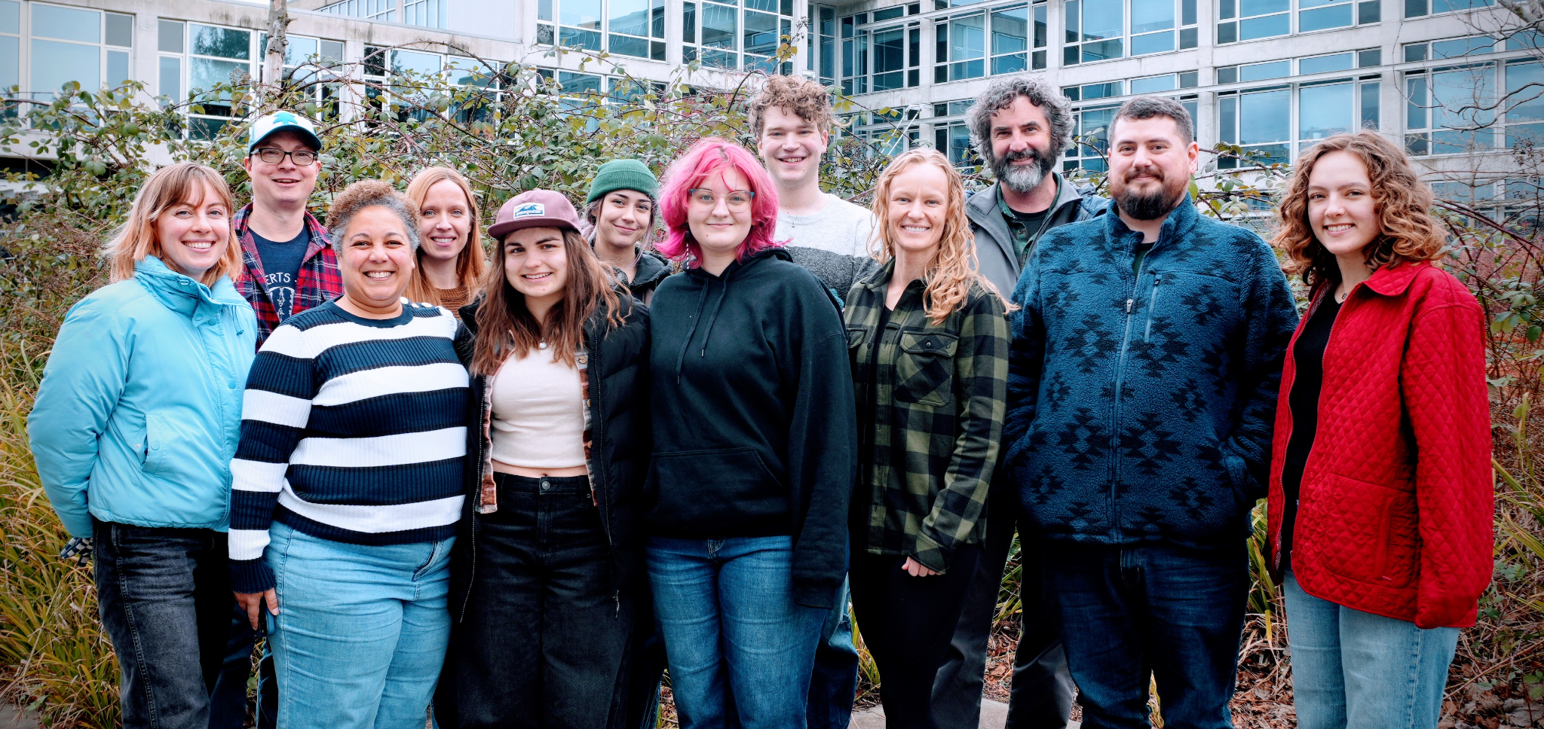









Thank you!
Roberts
Lab
Steven Roberts
Ariana Huffmeyer
Jill Ashey
Sam White
Roberts Lab
E5 Coral molecular working group
Steven Roberts
Hollie Putnam
Kerry Naish
The Roberts Lab
My Lab Notebook

Slide 26
Citations
Moorea image by Contains modified Copernicus Sentinel data 2021, Attribution, https://commons.wikimedia.org/w/index.php?curid=118352834

Slide 27
Color Scheme:
Dark (#0a1e29)
Dark (#023f54)
Light (#fbfbfc)
Accent (#0a958b)
Accent (#77978e)
Accent (#82825c)
Accent (#a22f06)
Accent (#8e6b33)

Slide 28
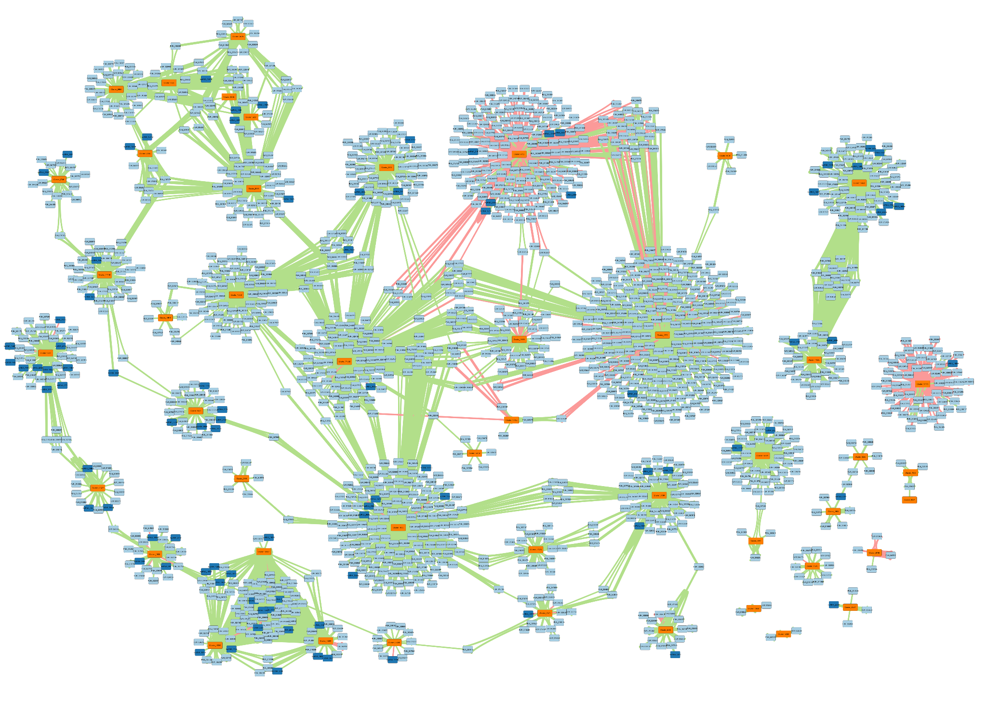
Complementary Analyses - integrating binding and expression correlation
47 miRNA
91 lncRNA
1,536 genes
Notes:
Should check proportional distribution of bindings to 3UTR, CDS, and 5UTR

Slide 29
Complementary Analyses - integrating binding and expression correlation
17 miRNAs interact solely with genes
30 miRNAs are bind and are significantly correlated with both genes and lncRNAs
8 possible lncRNA sponges (-)
47 miRNA
91 lncRNA
1,536 genes
Notes:
Should check proportional distribution of bindings to 3UTR, CDS, and 5UTR

Slide 30
Machine learning model – Elastic Net Regression
The problem: Huge list of candidates (lncRNA, miRNA, CpG sites), with many correlations
Lasso regression = “Harsh Editor”
Focuses on sparsity, removing irrelevant predictors to simplify the model
Ridge regression = “Compromiser”
Handles multicollinearity, retaining correlated predictors while reducing their individual impact
Elastic Net Regression
Notes:
Elastic Net regression combines penalities from both the Lasso and Ridge regression methods, combining their strengths. Long story short, Elastic Net Regression can effectively handle high-dimensional, correlated data, while procducing stable but interpretable models

Slide 31
Machine learning model – Elastic Net Regression
Glycolysis – GO:0006096
Gluconeogenesis – GO:0006094
Lipolysis/lipid catabolism – GO:0016042
Fatty acid beta oxidation – GO:0006635
Starvation – GO:0042594
Lipid biosynthesis – GO:000861
Protein catabolic process – GO:0030163
Biological relevance
Variability
Generalizability
Isolated genes associated with energy production, usage, and storage
Notes:
Why choose “energetic state” genes for use in the predictive model? Elastic net is a univariate regression model, meaning it can use a large predictor set to model the behavior of a *single* response variable (e.g. a gene) at a time. Due to computational requirements and the multiple testing problem, it was beneficial to choose a small set of genes as responses. When choosing genes we considered:
Biological relevance: As a fundamental biological process, we know their expression is intrinsically tied to physiology. Predicting their expression may allow us to also predict physiological state.
Variability: Similarly, know their expression is likely to be variable across time (supported by supported by differential host calcification, biomass, respiration over time), which will provide more information for model
Generalizability: core metabolic/energetic genes are more often highly conserved among taxa. Thus, the mechanisms of epigenetic modulation may also be generalizable

Slide 32
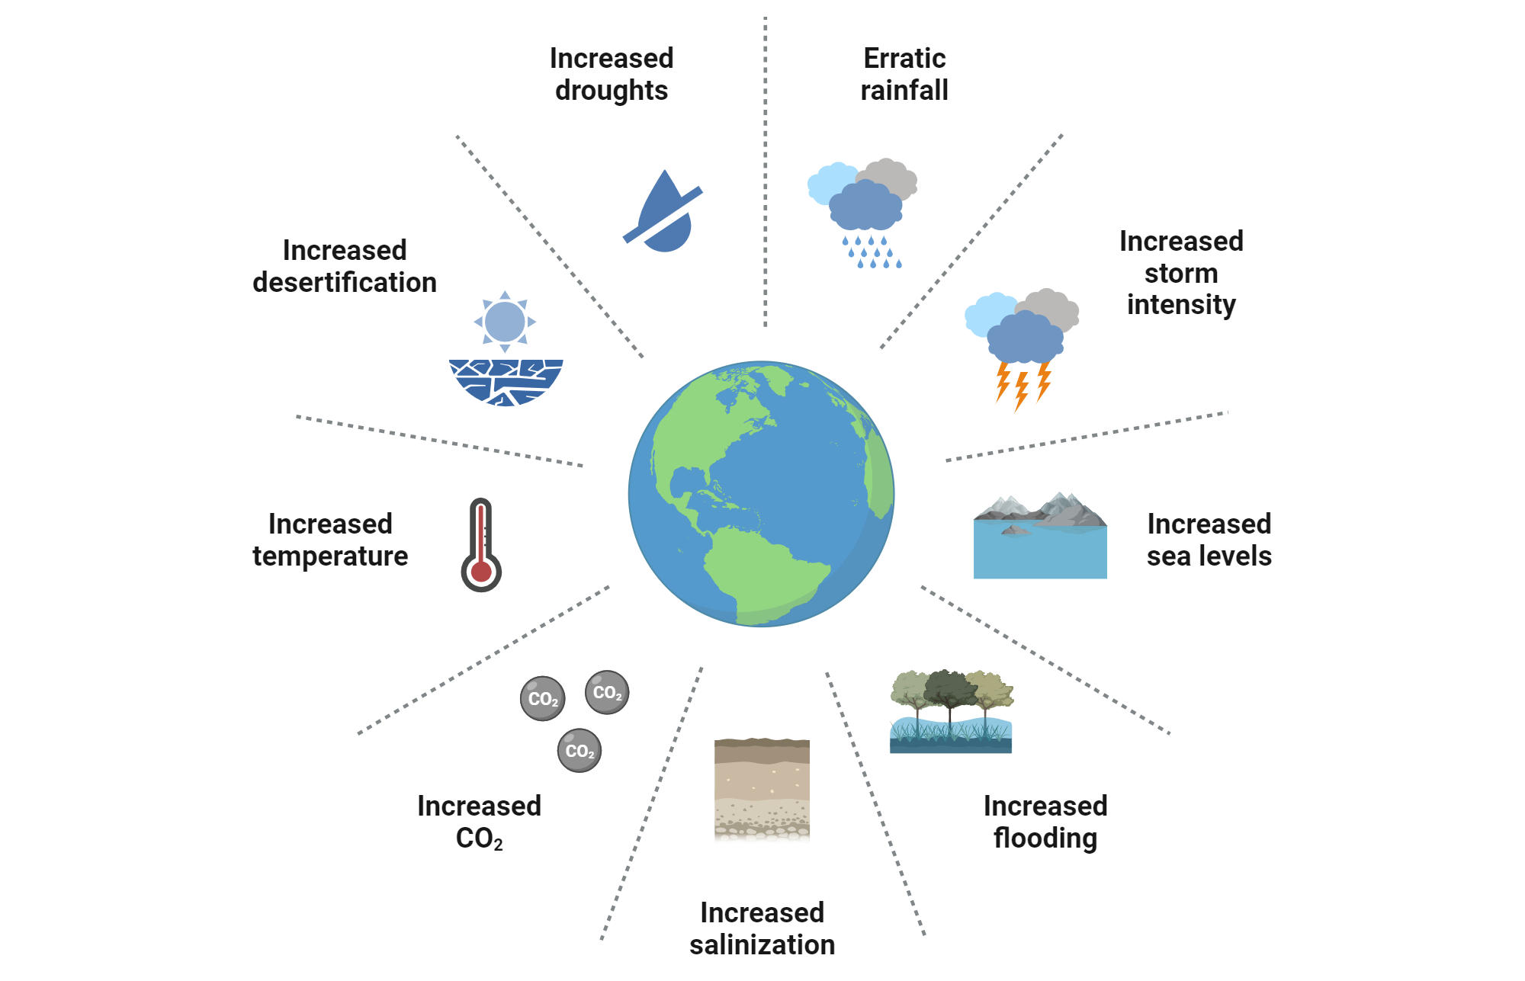
https://www.biorender.com/template/environmental-outcomes-of-climate-change
Notes:
As the climate crisis progress, relatively unchecked, there is a growing need to understand how organisms respond to environmental change

Slide 33
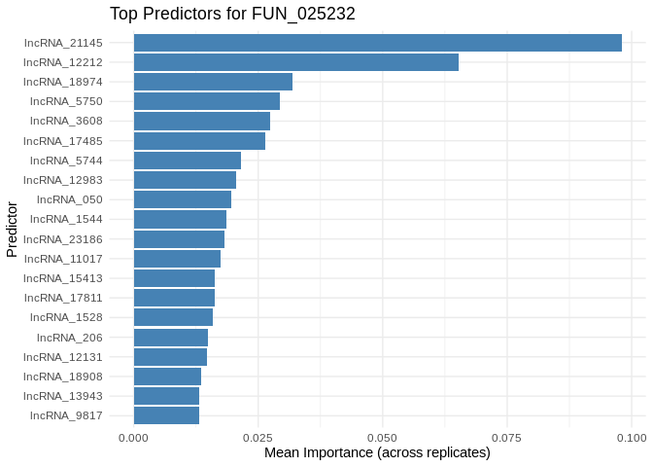
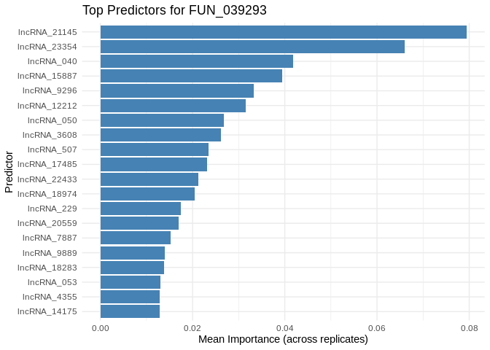
FUN_025232 & FUN_039293 – Glyceraldehyde-3-Phosphate Dehydrogenase (GAPDH)
Two of the best-predicted genes in our model.
Catalyzes a step in glycolisis, so central to glycolitic energy production.
Differentially expressed in a jellyfish under short-term temperature exposure (Gamero-Mora et al. 2024)
Despite the shared function, they have only one shared top-predictor (lncRNA_21145, the #1 predictor for both, inverse expression relationship for both)
Notes:
If I’m going to show the expression patterns, make sure the legend shows features in same order as importance plot

Slide 34
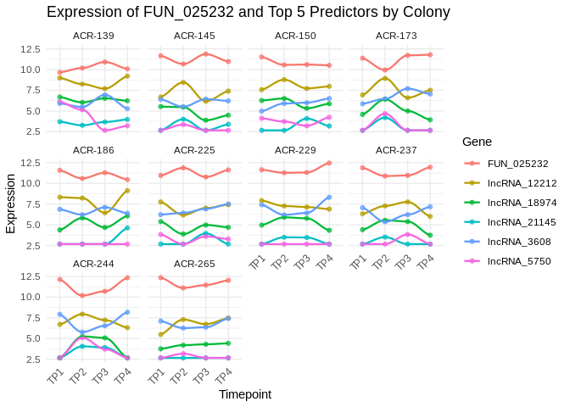
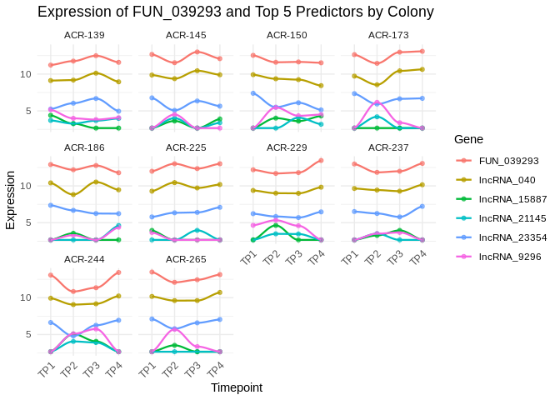
FUN_025232 & FUN_039293 – Glyceraldehyde-3-Phosphate Dehydrogenase (GAPDH)
lncRNA_21145 ⬇ lncRNA_12212 ⬇ lncRNA_18974 ⬇ lncRNA_5750 ⬇ lncRNA_3608 ⬆
lncRNA_21145 ⬇ lncRNA_23354 ⬆ lncRNA_040 ⬆ lncRNA_15887 ⬇ lncRNA_9296 ⬇
Notes:
If I’m going to show the expression patterns, make sure the legend shows features in same order as importance plot

Slide 35
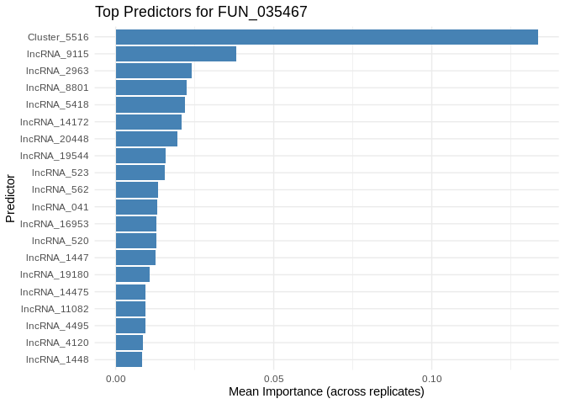
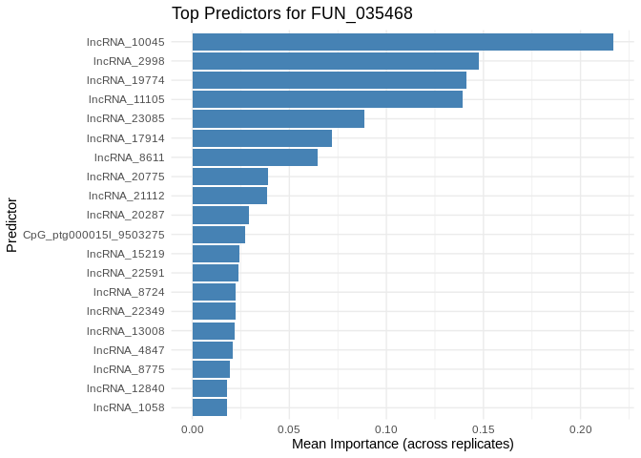
FUN_035467 & FUN_035468 – Phosphoenolpyruvate Carboxykinase [GTP], Mitochondrial (PEPCK-M)
A rate-limiting enzyme that catalyzes a step of gluconeogenesis, essential to maintaining glucose levels during fasting.
In corals, the PEPCK pathway has been identified as a potential carbon fixation pathway within coral hosts to supplement other CO2 concentrating mechanisms, used to accumulate dissolved organic carbon in service of their symbionts. (Zhang et al., 2024)
PEPCK is also differentially expressed under heat stress and bleaching (e.g., Kenkel et al. 2013, Lee et al. 2018, Kenkel et al. 2014), which suggests its involvement in compensating for loss of symbiont-derived nutrients.
Multiple classes of ncRNA have recently been identified as putative regulators of glucose metabolism, in which phosphoenolpyruvate carboxykinase plays a key role (e.g., Lai et al., 2020)
Also of interest because FUN_035467 has one primary predictor, and it’s an miRNA! (Cluster_5516). Cluster_5516 putatively binds to FUN_035467 in the 5UTR, but not to any of its top lncRNA predictors. Cluster_5516 and FUN_035467 are negatively coexpressed, indicating the miRNA is directly regulating its target through mRNA degradation. The lack of binding with any lncRNA suggests none are acting as ceRNA
Notes:
If I’m going to show the expression patterns, make sure the legend shows features in same order as importance plot

Slide 36
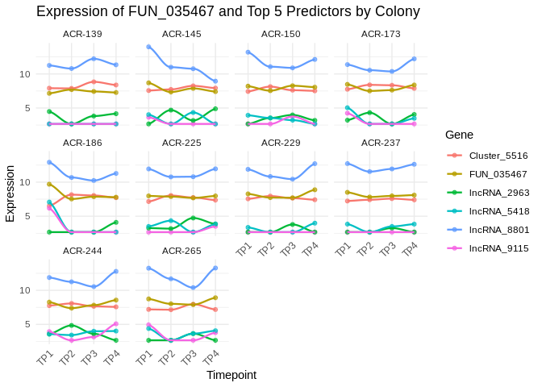
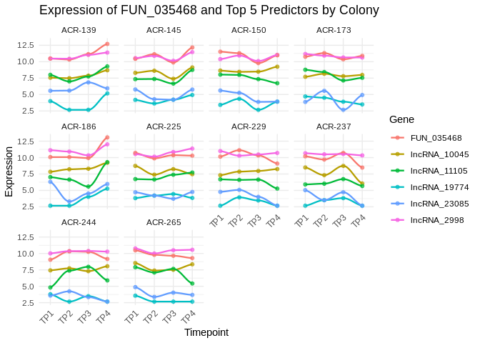
FUN_035467 & FUN_035468 – Phosphoenolpyruvate Carboxykinase [GTP], Mitochondrial (PEPCK-M)
Interestingly, while they code for the same protein and sit within 7kb of each other, FUN_035467 and FUN_035468 have different top predictors and exhibit different expression patterns
Notes:
If I’m going to show the expression patterns, make sure the legend shows features in same order as importance plot

Slide 37
Future work
Fine tune the model
Apply to other gene sets of interest
Physiology data, metabolomics
More to do with WGBS
Two additional species!
Outside the scope of this project, we need more experimental validation of putative epigenetic mechanisms (though this is complicated by low feature conservation)

Slide 38
FUN_025232 – Glyceraldehyde-3-Phosphate Dehydrogenase (GAPDH)
lncRNA_21145 ⬇ lncRNA_12212 ⬇ lncRNA_18974 ⬇ lncRNA_5750 ⬇ lncRNA_3608 ⬆
Notes:
If I’m going to show the expression patterns, make sure the legend shows features in same order as importance plot

Slide 39
FUN_025232 – Glyceraldehyde-3-Phosphate Dehydrogenase (GAPDH)
lncRNA_21145 ⬇ lncRNA_12212 ⬇ lncRNA_18974 ⬇ lncRNA_5750 ⬇ lncRNA_3608 ⬆
Notes:
If I’m going to show the expression patterns, make sure the legend shows features in same order as importance plot

Slide 40
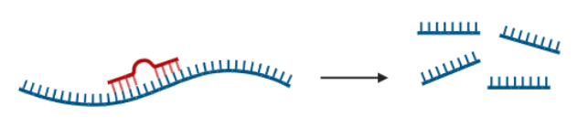
FUN_035467 – Phosphoenolpyruvate Carboxykinase [GTP], Mitochondrial (PEPCK-M)
Cluster_5516 ⬇ lncRNA_9115 ⬆ lncRNA_2963 ⬇ lncRNA_8801 ⬆ lncRNA_5418 ⬆
Cluster_5516 putatively binds to FUN_035467 in the 5UTR, but not to any of its top lncRNA predictors
Notes:
If I’m going to show the expression patterns, make sure the legend shows features in same order as importance plot

Slide 41

FUN_007022 – Cryptochrome-1 (CRY1)
lncRNA_14549 ⬆ lncRNA_5655 ⬇ CpG_ptg000015l_9999753 ⬇ lncRNA_11342 ⬇ Cluster_17173 ⬇
Cluster_17173 putatively binds to 3 locations of the FUN_007022 CDS.
Cluster_17173 putatively binds to 3 locations of lncRNA_5655
Notes:
If I’m going to show the expression patterns, make sure the legend shows features in same order as importance plot

Slide 42
FUN_025232 – Glyceraldehyde-3-Phosphate Dehydrogenase (GAPDH)
lncRNA_21145 ⬇ lncRNA_12212 ⬇ lncRNA_18974 ⬇ lncRNA_5750 ⬇ lncRNA_3608 ⬆
Notes:
One of the best-predicted genes in our model.
Catalyzes a step in glycolisis, so central to glycolitic energy production.
Differentially expressed in a jellyfish under short-term temperature exposure (Gamero-Mora et al. 2024)

Slide 43
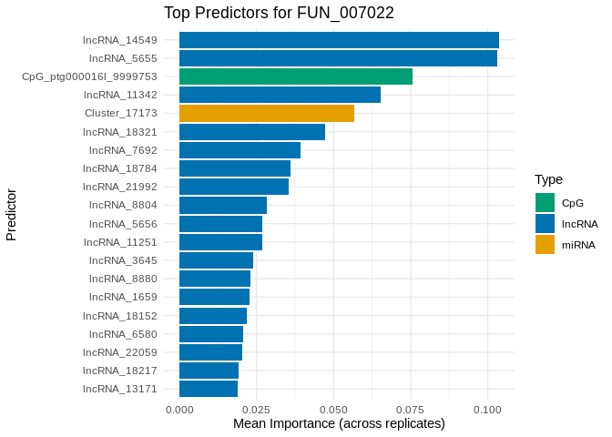
FUN_007022 – Cryptochrome-1 (CRY1)
lncRNA_14549 ⬆ lncRNA_5655 ⬇ CpG_ptg000015l_9999753 ⬇ lncRNA_11342 ⬇ Cluster_17173 ⬇
miRNA binds to gene (CDS)
miRNA binds to lncRNA_5655
Notes:
Core component of circadian clock, modulating metabolic pathways in time-dependent manner.
In plants, cryptochromes may be regulated by a network of miRNA and lncRNA
In corals, cryptochromes are involved in photoreception, potentially influencing behavior synchronization (e.g. mass spawning)
Cluster_17173 putatively binds to 3 locations of the FUN_007022 CDS.
Cluster_17173 putatively binds to 3 locations of lncRNA_5655

Slide 44
FUN_035467 – Phosphoenolpyruvate Carboxykinase [GTP], Mitochondrial (PEPCK-M)
Cluster_5516 ⬇ lncRNA_9115 ⬆ lncRNA_2963 ⬇ lncRNA_8801 ⬆ lncRNA_5418 ⬆
miRNA binds to gene (5’UTR)
Notes:
A rate-limiting enzyme that catalyzes a step of gluconeogenesis, essential to maintaining glucose levels during fasting.
In corals, the PEPCK pathway has been identified as a potential carbon fixation pathway within coral hosts to supplement other CO2 concentrating mechanisms, used to accumulate dissolved organic carbon in service of their symbionts. (Zhang et al., 2024)
PEPCK is also differentially expressed under heat stress and bleaching (e.g., Kenkel et al. 2013, Lee et al. 2018, Kenkel et al. 2014), which suggests its involvement in compensating for loss of symbiont-derived nutrients.
Multiple classes of ncRNA have recently been identified as putative regulators of glucose metabolism, in which phosphoenolpyruvate carboxykinase plays a key role (e.g., Lai et al., 2020)
Cluster_5516 putatively binds to FUN_035467 in the 5UTR, but not to any of its top lncRNA predictors

Slide 45
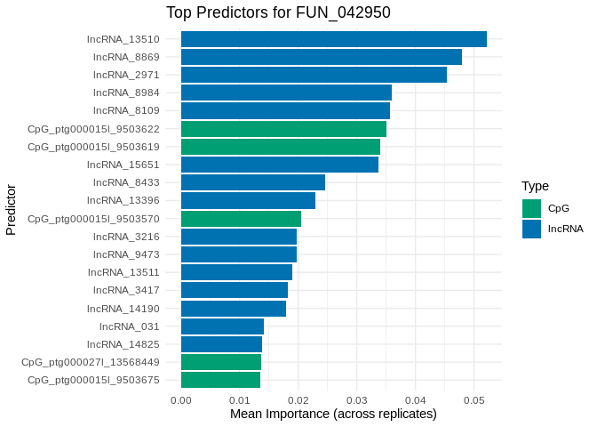
FUN_042950 – TNF Receptor-Associated Factor 2 (TRAF2)
predictive CpG sites are adjacent (within 100 bp)
Notes:
In general, tumor necrosis factors (TNFs) play a role in apoptosis, and are associated with immune response and cellular stress response.
TRAF2, specifically, suppresses apoptosis and necroptosis (Petersen et al. 2015) In humans, dysregulation of TNFs and TRAFs is implicated in several cancer types.
TRAF2 has also been implicated as part of an immune regulation network that is modulated by both miRNA and lncRNA (Ebrahimi & Golestani 2021).
In Acropora hyacinthus, TNF receptor-associated factor 2 is downregulated in response to bleaching (Barshis et al., 2013).

Slide 46
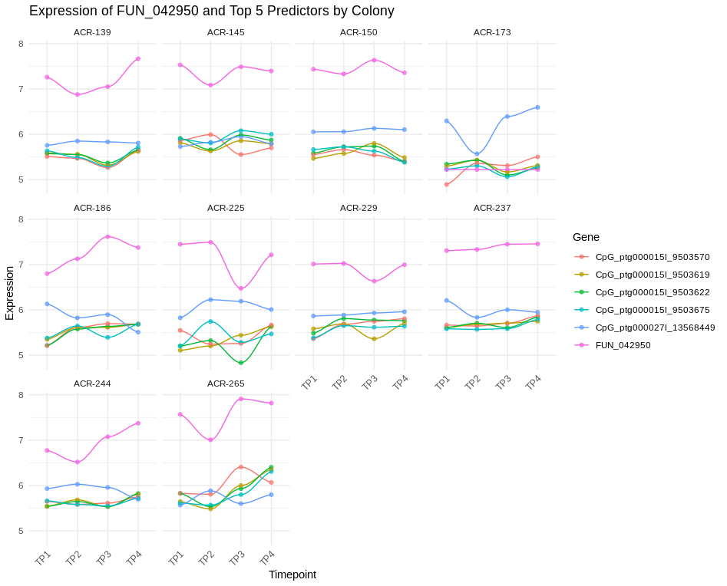
FUN_042950 – TNF Receptor-Associated Factor 2 (TRAF2)
predictive CpG sites are adjacent (within 100 bp)
Notes:
Core component of circadian clock, modulating metabolic pathways in time-dependent manner.
In plants, cryptochromes may be regulated by a network of miRNA and lncRNA
In corals, cryptochromes are involved in photoreception, potentially influencing behavior synchronization (e.g. mass spawning)
Cluster_17173 putatively binds to 3 locations of the FUN_007022 CDS.
Cluster_17173 putatively binds to 3 locations of lncRNA_5655

Slide 47
Summary of findings
Binding prediction and pairwise correlation analysis can help construct interaction networks for miRNA and their targets
Most miRNA interactions are non-canonical
Machine learning models can identify features likely to drive gene expression, and their degree of importance
A subset of genes involved in energy regulation are well predicted by epigenetic features
lncRNA emerge as primary predictors
Mechanisms of influence for many miRNA, lncRNA, and methylated sites remain unclear

